Slide 1


Cognitive and Memory game
Java Technology
Group 10
Lecturer: Nguyen Van Tan.

Slide 2
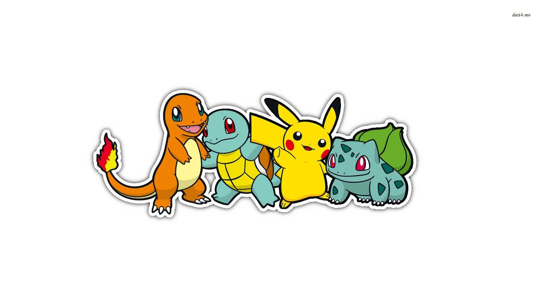

Member:
Trần Ngọc Thảo Vy | 205051850
Lê Thái Phi | 205052015
Nguyễn Huỳnh Như | 205051960

Slide 3
INTRODUCTION
Java is an object-oriented programming language (titled C++) released by Sun Microsystems in the mid-1990s.
A Java topic must highlight the nature of the subject, be practical and bring practicality and can be implemented in practice. It is for these reasons that we have decided to choose the topic Flipping game as the final topic of this course.
Functions of the game: create a new game screen, play again, pause, continue playing, score, announce results, exit the game, play instructions, change the interface.
Graphics requirements: the game must be designed so that it is easy to use, reasonably designed to be easy to manipulate.
Handle in-game player events: tile flips, tile clears, button click events.

Slide 4
Programming a Flip Game With Java
Flipping game is a game familiar to most people. To make the game more interesting, try with pictures of your crush, maybe you can practice your coding skills and crush your crush with this simple game.
The game rules are very simple
Each screen will have 2 * k (an even number) of hidden pictures, the pictures do not change position in each level. You can open two pictures consecutively (you will see the two pictures) if the two images are the same they will be deleted, otherwise the two pictures will continue to be hidden.
When you open all the same pairs of pictures, the game screen will end, to make the game more interesting, there will be time pressure in each level, requiring you to be very calm to remember the position of the player. pictures.

Slide 5
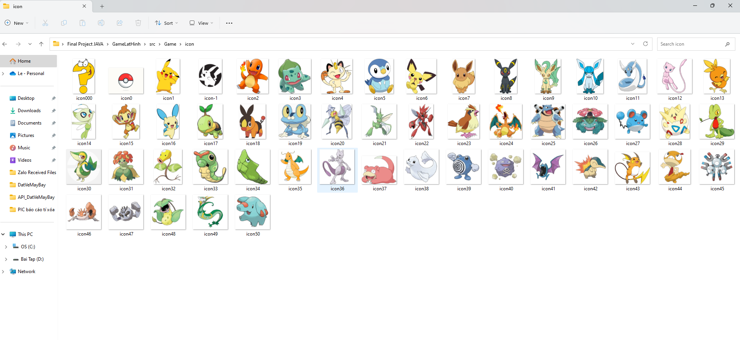
Initialize the data and set the interface.
Image
To make this game you need a number of different images.
Your names should be in the order shown below, for example icon1.jpg, icon2.jpg, icon2.jpg, ...
Figure: Images use for User Interface Flipping game

Slide 6
Matrix - image representation
We can see that each number represents an image, two images are similar if the values in their respective matrices are equal.
If in that level the pictures are arranged in m rows and n columns. We will use matrix a to represent those images.
We see that, in a matrix, the numbers always appear in the matrix exactly twice, so how to set up such a matrix, especially since it must be randomly arranged.
For example, if you have the most image images, you need to create a matrix of size m * n for the game, the first thing you need to do is select (m * n) / 2 images in your image images. , then just double its count.

Slide 7
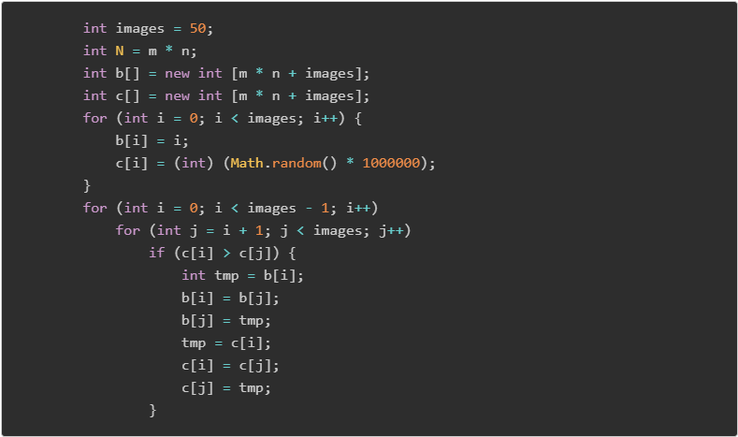
After executing the above code, then the first m * n / 2 elements of sequence is how the discriminant index of the images (no two numbers are the same)
We will double the m * n / 2 of the first number of b.

Slide 8
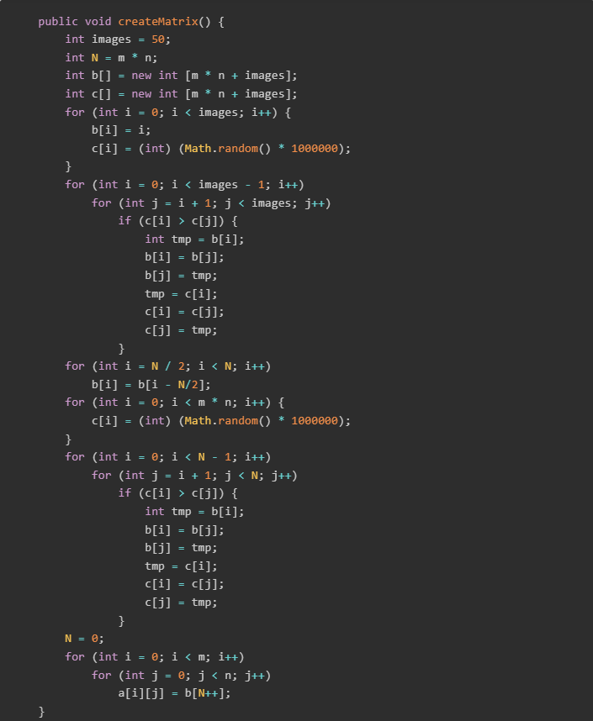
Finally, randomly sort the sequence b from 0 to m * n - 1 and put it in matrix a. Full program for creating matrix a:

Slide 9
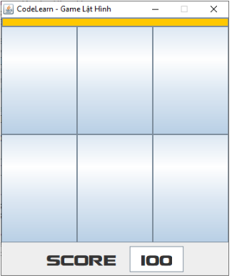
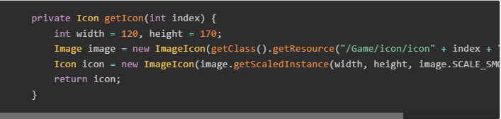
Add images to the interface.
The main interface will include Jbuttons in the JFrame class as follows:
To put an image in, we just need to use the setIcon() function. However, each image will receive a different image, so we need to add the getIcon() function as follows:

Slide 10
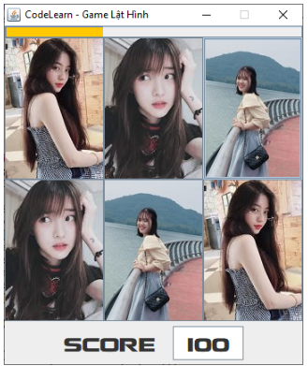
To put the image corresponding to the button (i, j) we will use the command bt[i][j].setIcon(getIcon(a[i][j])), Then the interface will be:

Slide 11
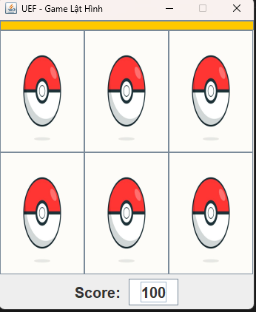
Handling operations
Click an image
When starting the game, we will hide the images, for example:

Slide 12
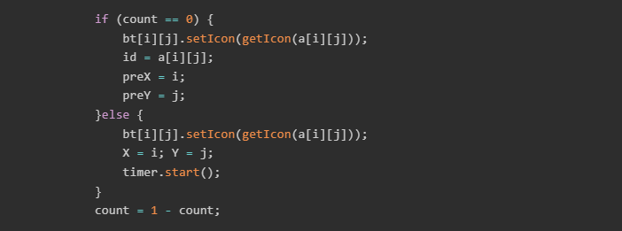
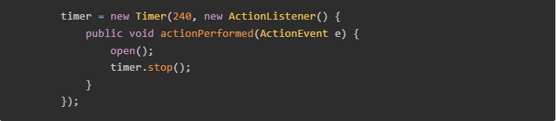
We noticed that, when we click on the image for the first time, it immediately opens that image, when we open the image for the second time, we need to check if they are the same or not, if they are the same, delete those two images, and If not, then put those two images in the hidden state.
Use the Timer class to check the image, and create a delay effect when checking the image.

Slide 13
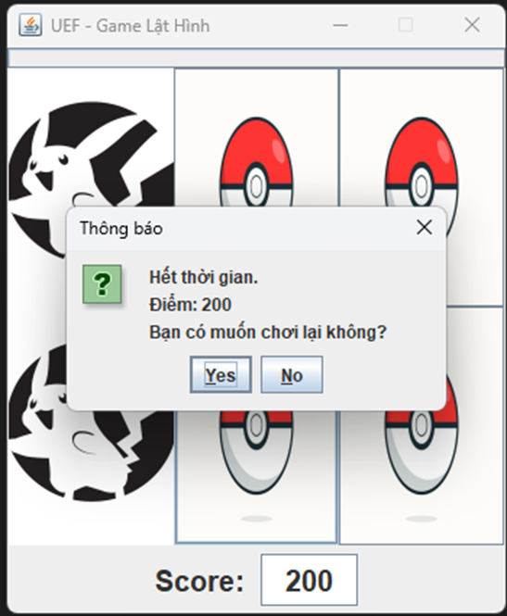

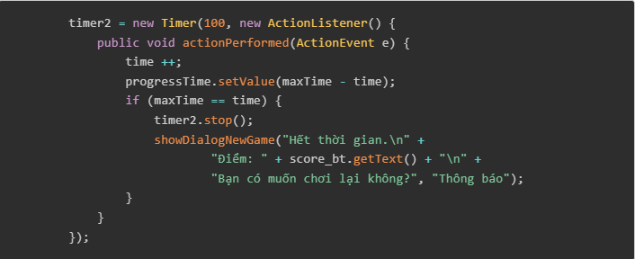
Time in the game screen
To create the time bar as shown above we use JProgressBar in JFrame
Incorporating Timer (will run when the button is clicked):

Slide 14
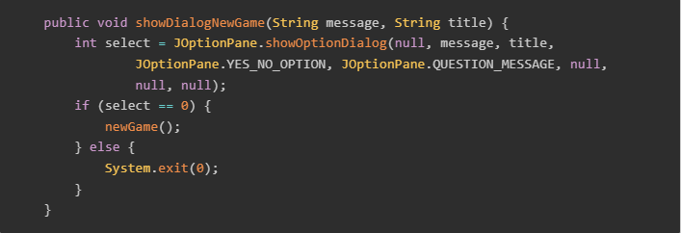
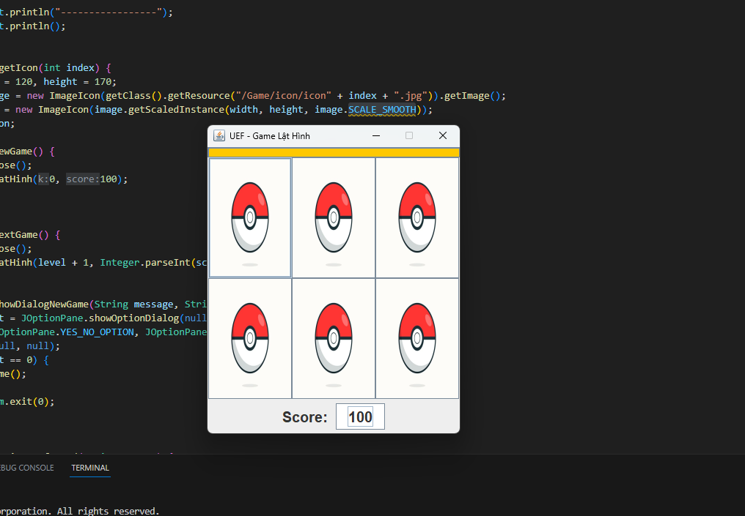
The function displays the message:
UI start Game

Slide 15
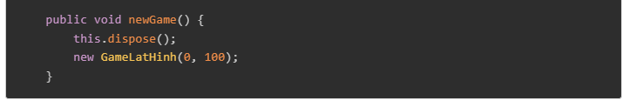
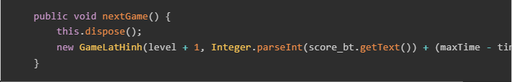
New game and Next level
Hàm newGame():
The nextGame() function is similar, but note that you must pass additional parameters to save the number of points obtained in the previous screen.

Slide 16
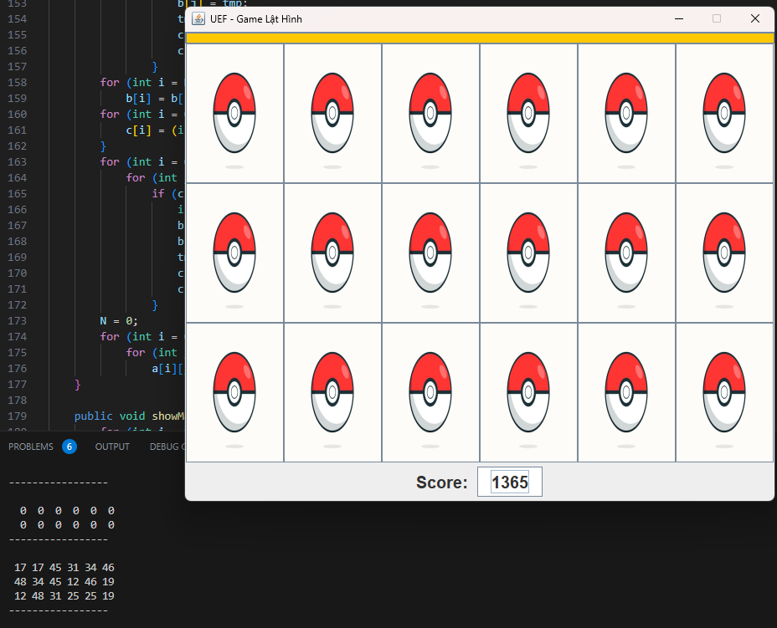
When the level of the game is observed, the level will be increased, the difficulty will be higher.
When declaring the variable to store score:

Slide 17
DEMO PROJECT

Slide 18


Thanks for you listening

